Slide 1
_Calm Space_
Exploring Students' Social Media Addiction:
Survey Insights Q1 2025
Mikhael Putra Iswanto
RevoU - FSDA Madrid batch JUN25
Source Collab Tableau Slide

Slide 2


_Calm Space_
Industry Model & Business Processes
An B2B SaaS EdTech company focuses on student well-being and engagement through a platform that monitors social media usage, sleep patterns, and potential conflicts. The platform also provides data-driven interventions to support mental health and academic performance.
Primary revenue comes from annual licenses offered and additional revenue through professional consulting and premium analytics packages.
> Stakeholder Analysis
Decision Maker - CEO
Consulted - Psikolog, Teacher Advisor Informed - School board, All teaching staff, students
(Approver)
Head of Data & Research
(Responsible)
Data Analyst
Data Collection
Analytics
Intervention
Reporting
Business Ops

Slide 3
_Calm Space_
Methodology
1
Defining
the problem
2
Data cleaning & preparation
3
Exploratory data analysis
4
Analysis Framework
5
Insights & recommendation
Exploratory and understand data and problem
Determine the user using DARCI
Define Objective
Data cleaning & preparation using Python
EDA using python, & tableau
Segmentation
Correlation
Summary of the remarkable insights & Recommendations

Slide 4
Objective (Root Causes Analysis)
_Calm Space_
Scope
Identify the quantitative relationship between social media usage hours and mental health outcomes, sleep duration, and frequency of social conflicts.
Segment users (students) by gender, academic, country and usage patterns to understand intervention priorities per market.
Build a simple predictive model that can estimate the risk of interpersonal conflict based on surveys.
Provide actionable recommendations for stakeholders.
The variables analyzed are limited to
Social Media Usage - Avg_Daily_Usage_Hours, Most_Used_Platform, Addicted_Score.
Well-being & Health - Sleep_Hours_Per_Night, Mental_Health_Score.
Social Interaction - Conflicts_Over_Social_Media, Relationship_Status.
Demografi - Gender, Age, Academic_Level
All data is questionnaire-based, so its validity is limited.
The data only describes a single point in time, not a cause-and-effect relationship.
The results apply to the dataset respondent population and cannot be directly generalized to all students globally.
Actionable insights are intended for school boards, teachers, and psychologists, not for clinical decisions.

Slide 5
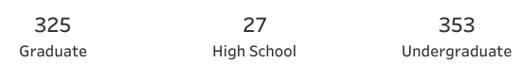

Business Problem
Hypothesis
_Calm Space_
“Within 6 months, Calm Space aims to reduce incidents of interpersonal conflict among students due to excessive social media use by 15%, by increasing average sleep quality by more than 30 minutes per night and lowering self-reported anxiety levels.”
Student who use social media more than 5 hours/day have risk of interpersonal conflict that is twice as high as student who use social media for less than 3 hours/day.
Students who sleep less than 6 hours/day tend to have anxiety/depression scores that are 25% higher than those who sleep 7 hours or more per day.
The Combination high screen time (> 5 hours/day) & short sleep (< 6 hours/day) increases risk of interpersonality conflict 2 times compared with low screen time & enough sleep.
Key Metrics (Conflict Rate, Average Sleep Duration, Screen Time Hours, Anxiety/Mental Health Score)
Total. Responden Survey

Slide 6
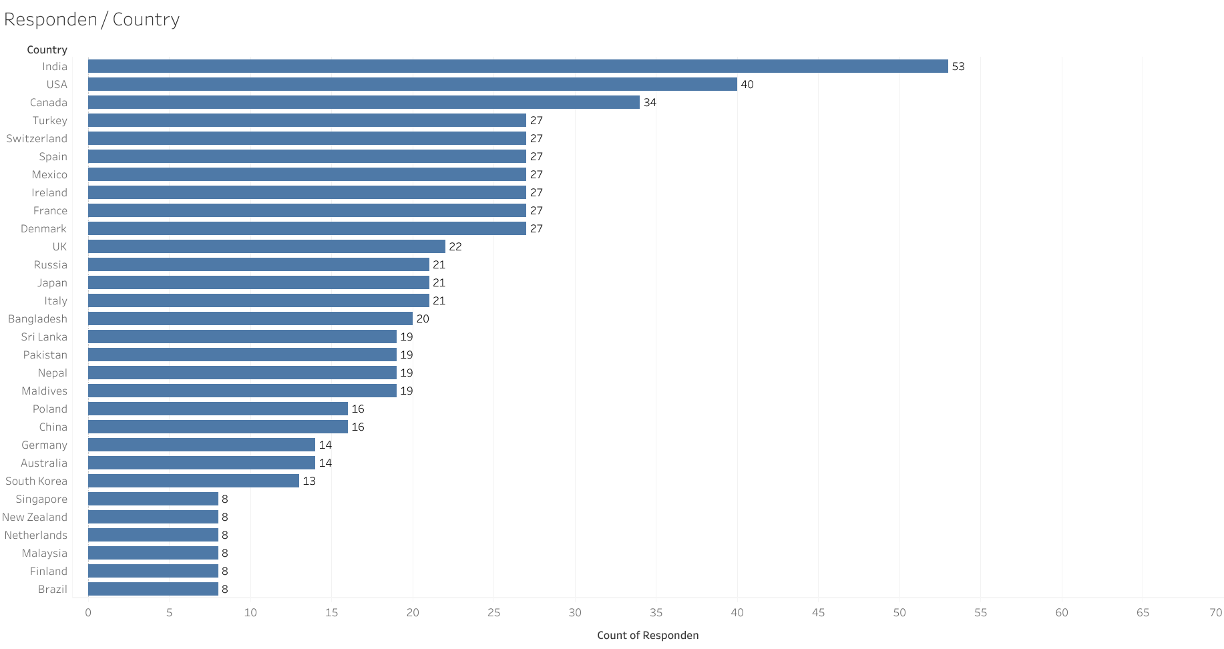
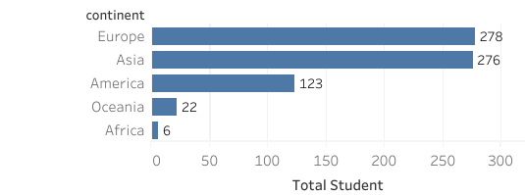
Country of Responden
The survey was conducted across five continents, but respondents were concentrated in India, the United States, and Canada, which may indicate greater access to the survey in those regions or a bias in the distribution of the survey.

Slide 7
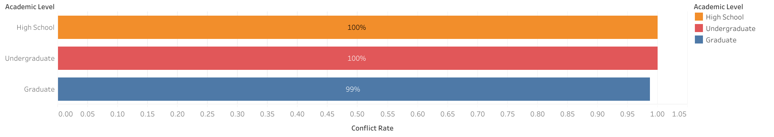
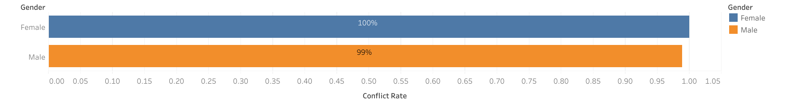


Almost All Respondents have Conflict Rate Over Social Media
Almost all respondents reported conflicts, indicating that the problem is systematic rather than individual/personal.
The level of education did not have a significant effect on reducing conflicts, although it appeared to be better at the graduate level.
The differences between genders were very small, indicating that conflicts were fairly evenly distributed and not biased towards a particular gender.

Slide 8
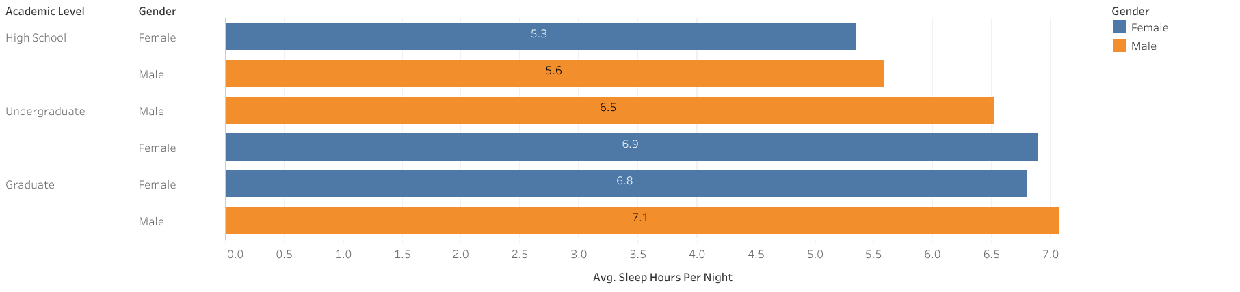

Average Sleep Duration Responden
High school students show the highest potential for sleep deprivation, sleeping less than 6 hours.
Graduate students have the highest average number of hours of sleep, with males sleeping slightly longer than females.
There is an pattern increase in hours of sleep as the level of education increases.

Slide 9
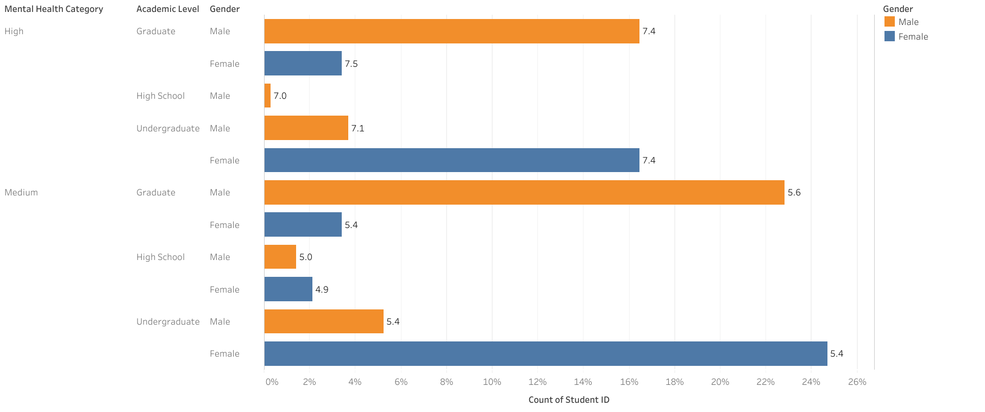
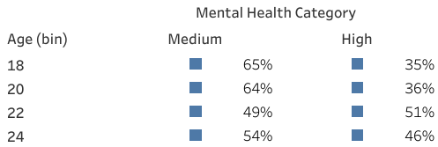


Anxiety/Mental Health Score Responden uses social media
The overall average of respondents was in the medium category (6.2).
Females tended to have higher scores in the high category than males, except at the undergraduate level.
The high anxiety category was quite dominant at all academic levels, especially at the graduate and undergraduate levels.
High school respondents were relatively fewer, but when high, they showed significant scores (7.0–7.1).
Mental health is highest at age 22 and lowest at ages 18–20.

Slide 10
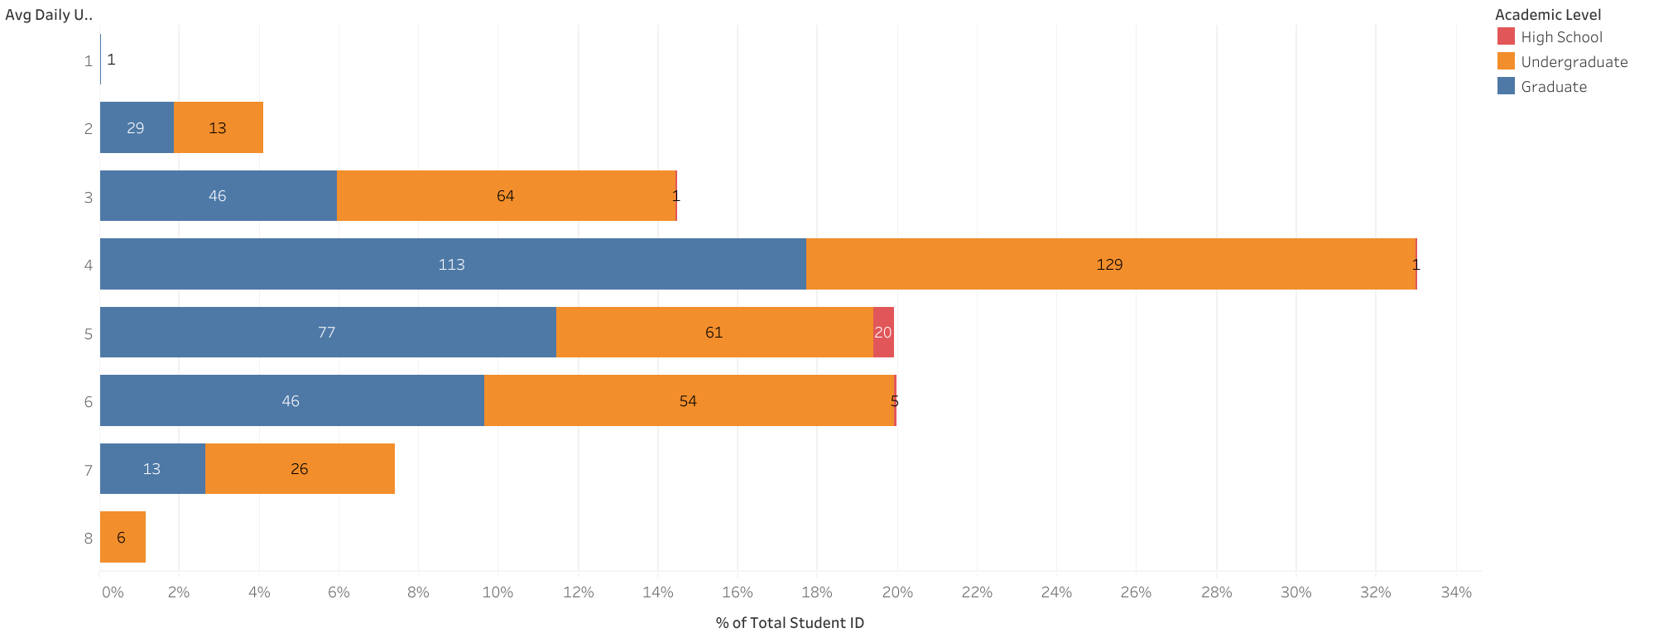


Screen Time Responden
Students dominate usage for 4-6 hours per day.
Undergraduates use social media most intensively on a daily basis, with some even reaching 8 hours per day.
Graduate students are relatively balanced (3-6 hours) and rarely exceed 7 hours per day.
High school students use social media less, but still significantly, up to 5 hours per day.
Social media usage has become a dominant daily routine rather than just an additional activity.

Slide 11
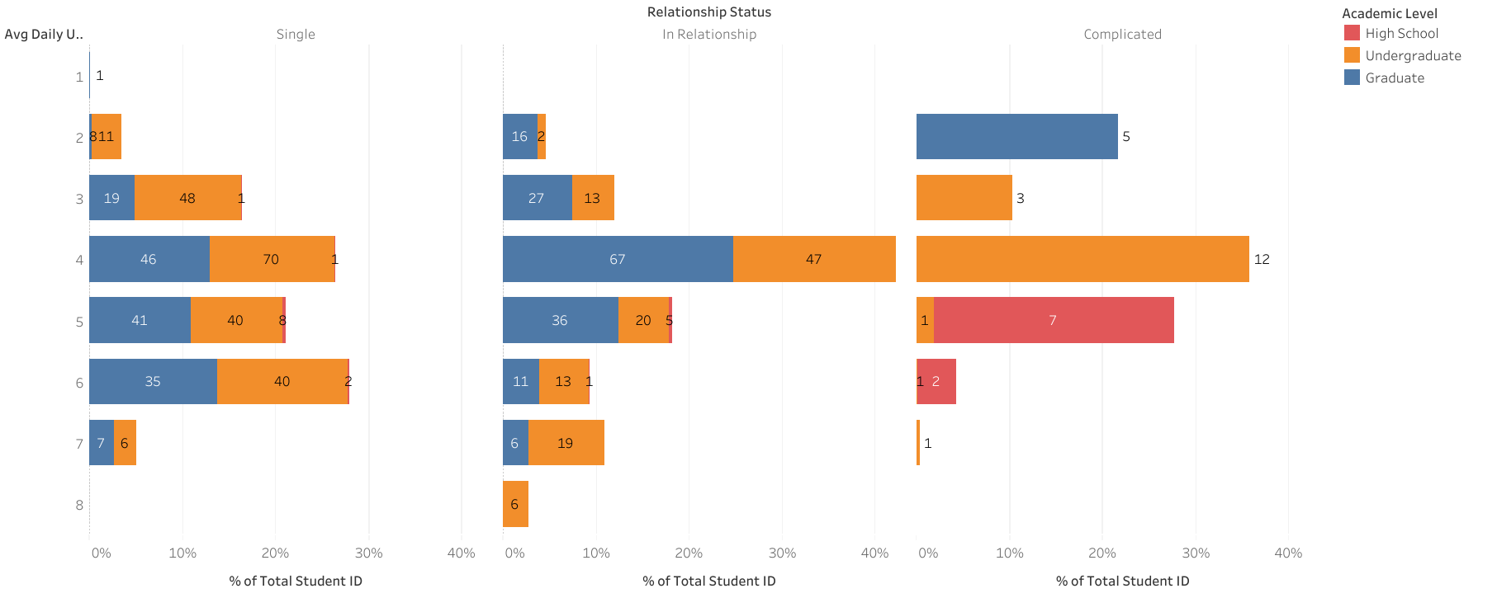
Correlation of Relationship with Screen Time Responden
Undergraduate students with a relationship status of “single” or “complicated” are at risk of excessive screen time (≥5 hours/day), which can potentially reduce mental health and productivity.
Undergraduates are the group most vulnerable to excessive screen time, not high school students.
The “complicated” relationship status triggers extreme screen time patterns, potentially impacting mental health.

Slide 12
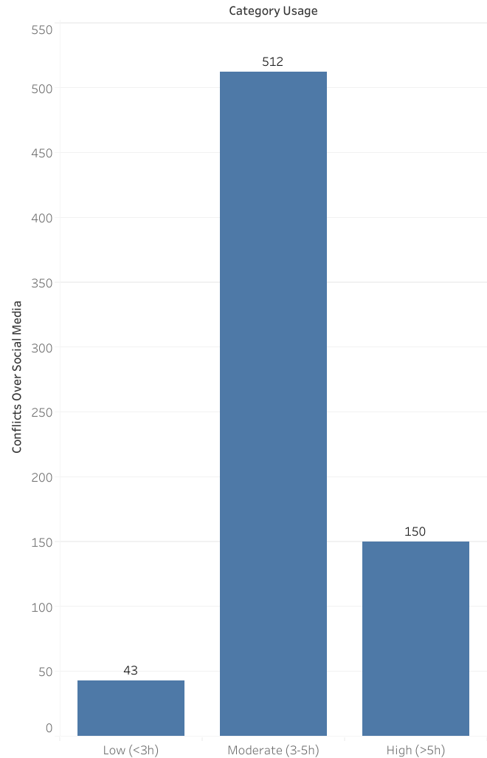
Correlation of Screen Time Responden with conflicts
> Insight
The “Moderate” zone (3–5 hours) is actually the most prone to conflict.
Conflict is not linear with screen time.
It is possible that those who are online for a very long time (>5 hours) are more “passive/observing” and therefore less involved in direct conflict, while those who are online for 3–5 hours are more actively interacting.
> Recommendation
Adakan workshop tentang etika komunikasi digital dan cara mengelola emosi saat online. Fokus pada siswa dengan screen time 3–5 jam/hari.
Dorong siswa untuk lebih banyak melakukan interaksi positif, seperti kerjasama akademi, berbagi karya, atau diskusi sehat. Tingkatkan kualitas, bukan hanya kurangi waktu layar.
Gunakan alat bantu monitoring dan refleksi.

Slide 13
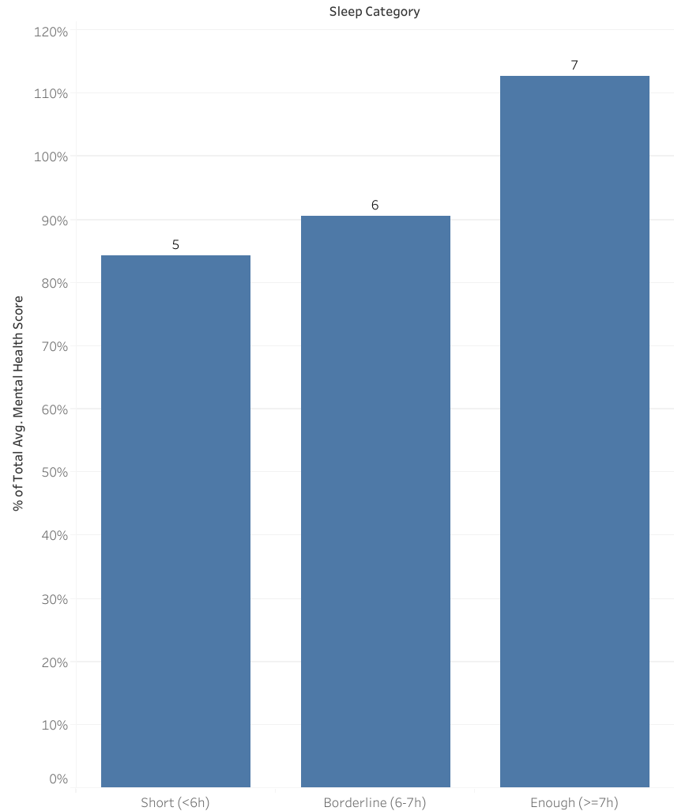
Correlation of Screen Time Responden with Mental Health
> Insight
Sleep duration is one of the key factors affecting mental health.
Consistently getting 7 hours of sleep supports a healthier psychological condition (113%).
Less than 6 hours of sleep shows the lowest health score (-85%).
> Recommendation
Education for students on factors that disrupt sleep (screen time & sleep routines)

Slide 14
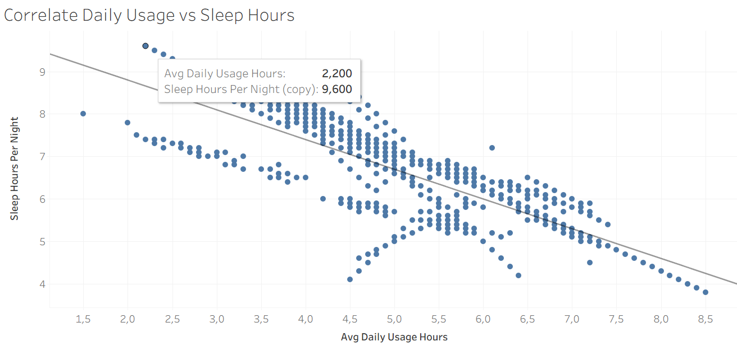
A strong negative correlation between daily usage duration and hours of sleep
The longer a person uses social media, the fewer hours of sleep they get.

Slide 15
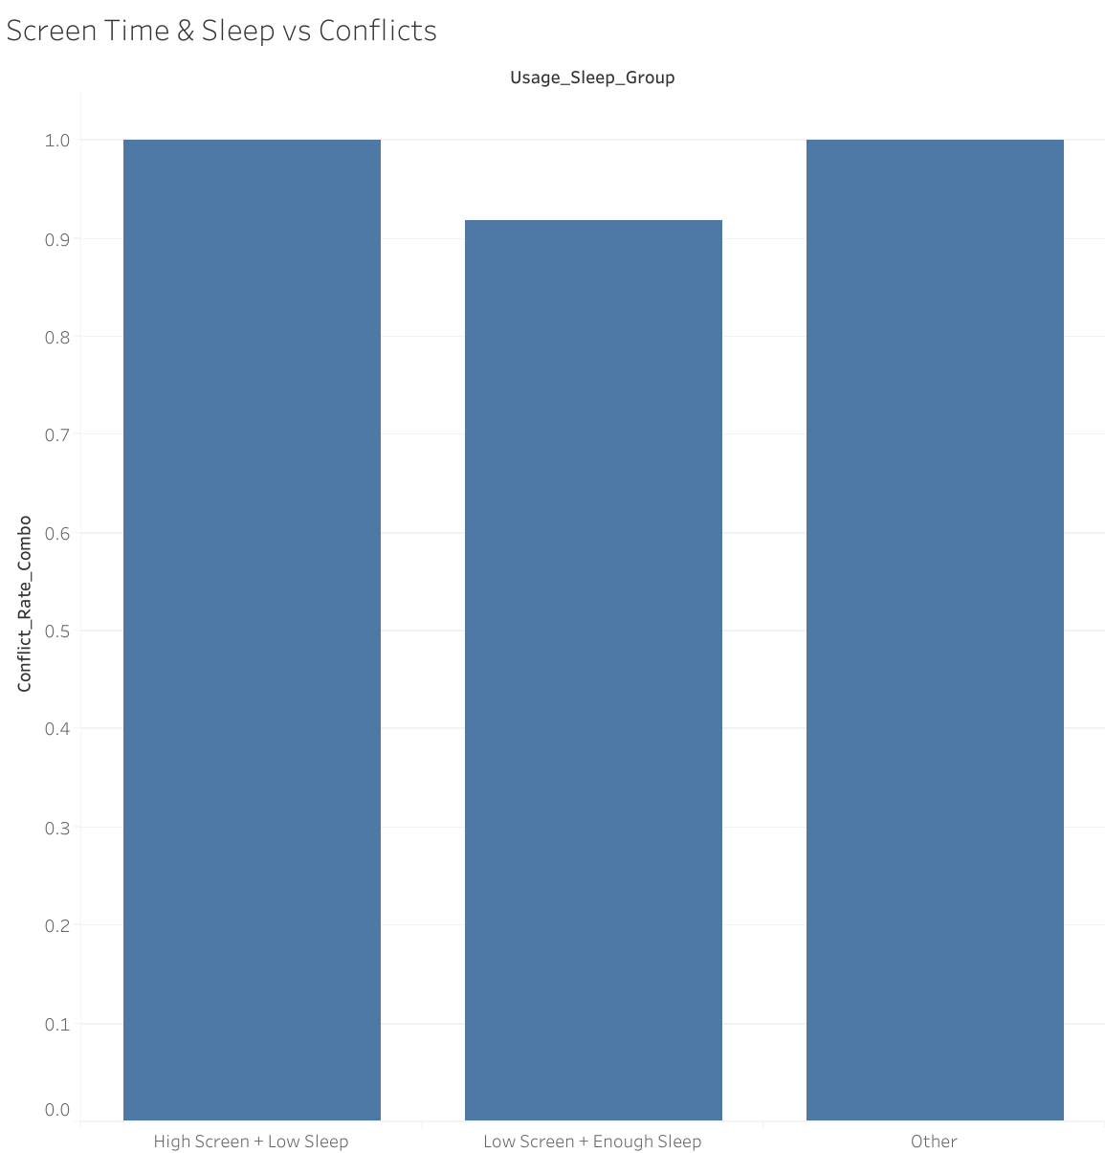
Correlation of Screen Time & Time Sleep Responden with Conflicts over Social Media
> Insight
The combination of screen use and lack of sleep contributes to conflict (score 1.0).
Low screen time and adequate sleep help reduce the potential for conflict.
Groups with inconsistent sleep/screen time patterns remain vulnerable to conflict.
> Recommendation
Educate parents and students about screen time + sleep and how to improve sleep quality and duration Reduce excessive screen time
Provide positive alternative activities

Slide 16
Summary Insight & Recommendation
_Calm Space_
Conflict are Systematic, not isolated
Strong negative correlation between screen time & sleep
Sleep is a Key Mediator, Students sleeping <6H have the lowest mental health scores (-85%)
Undergraduates, especially “single”/“complicated” status, are most vulnerable to conflict and anxiety.
Graduate students show more balance (3–6h usage, 7h sleep).
The “moderate” usage group (3–5h/day) is paradoxically most conflict-prone, possibly due to higher interaction intensity.
Focus Q2 2025 on sleep extension (+30 min avg) and screen time moderation.
Target undergraduates with “single/complicated” status as high-risk group.
Deploy gamified digital detox campaigns.
Provide institutional wellness dashboards to demonstrate progress.
Expected outcome: –15% conflict reduction, lower anxiety prevalence, and stronger Calm Space brand as a digital wellness solution in education.

Slide 17
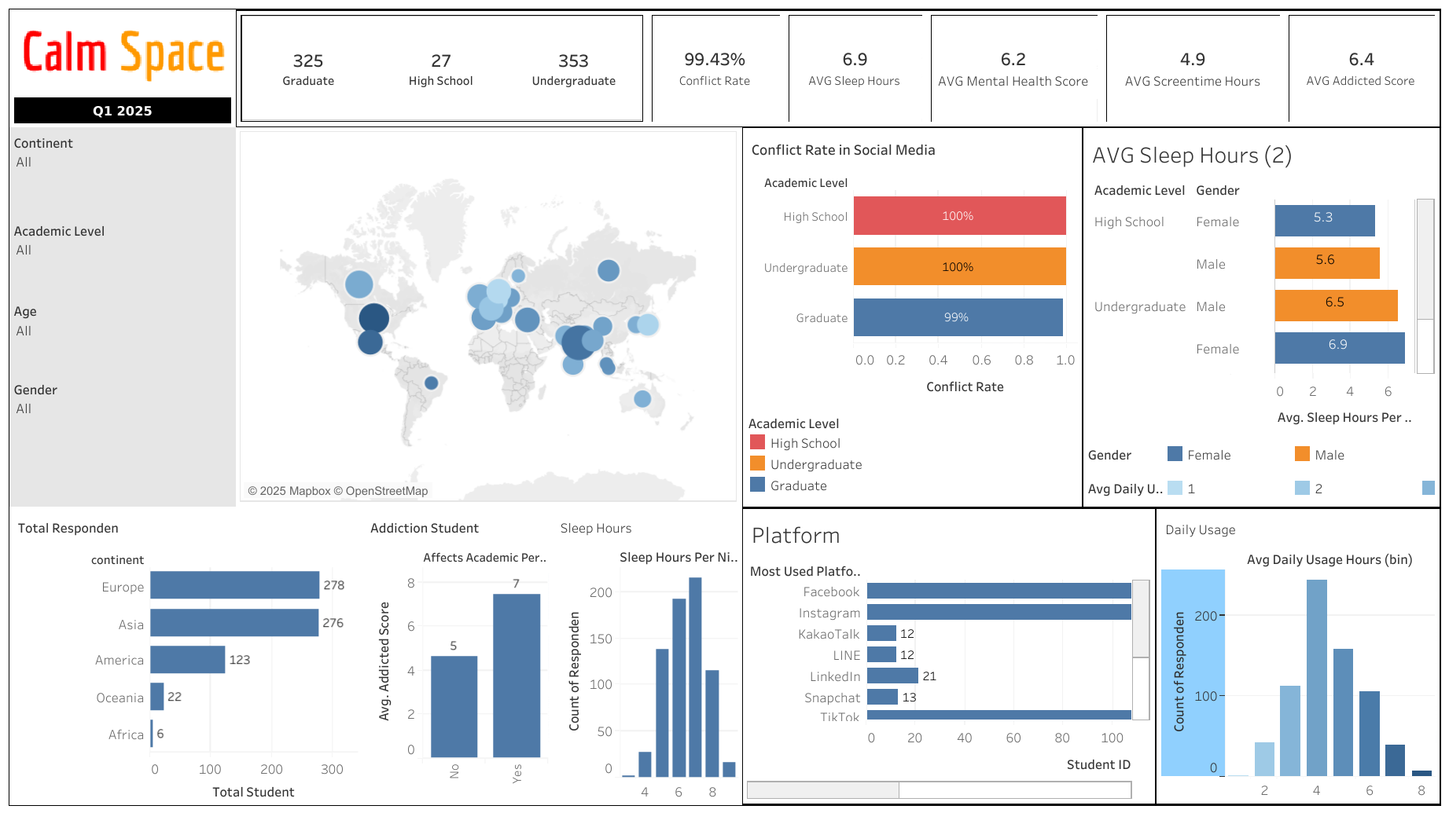
Dashboard

Slide 18
QnA

Slide 19
Thank You
Exploring Students' Social Media Addiction: Survey Insights from Q1 2025
Mikhael Putra Iswanto
RevoU - FSDA Madrid batch JUN25
Source Collab Tableau Slide

Slide 20
APPENDIX
Link Python

Slide 21
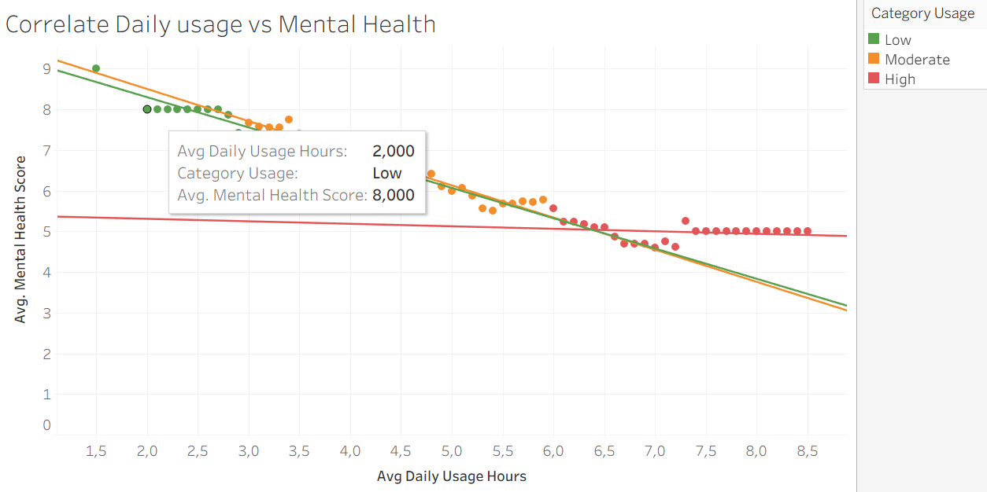
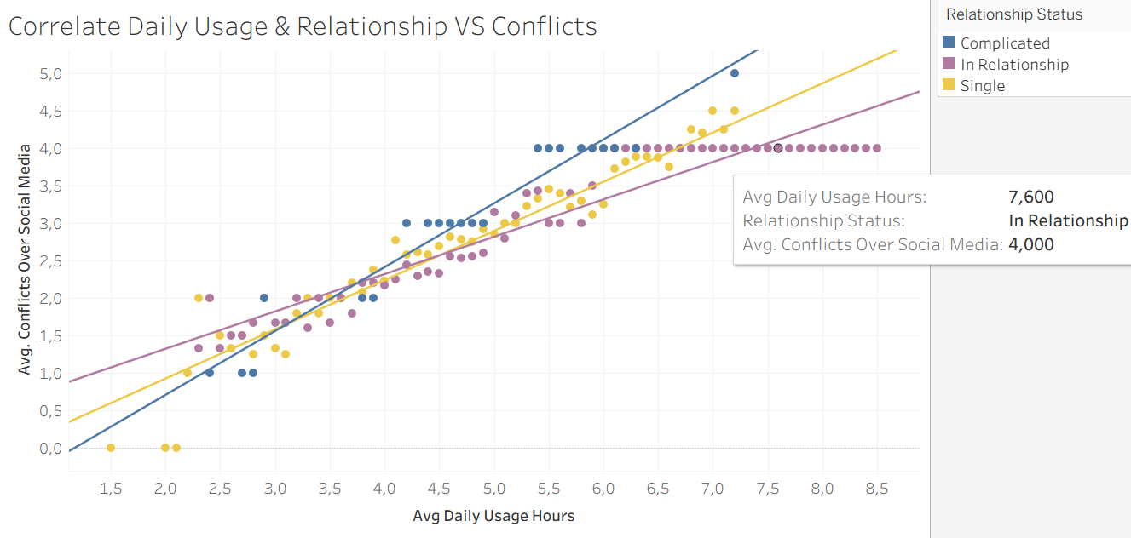
Correlation
Excessive social media use (more than 5 hours/day) is strongly correlated with poorer mental health.
The most significant impact is seen among low and moderate users, while high users are already at a low point and do not deteriorate much further.
Positive correlation: the higher the daily use of social media, the higher the conflict on social media
Relationship status is related to this correlation, with the highest conflict occurring among those with a “Complicated” status, followed by “Single,” and the lowest among those “in a relationship”.

Slide 22
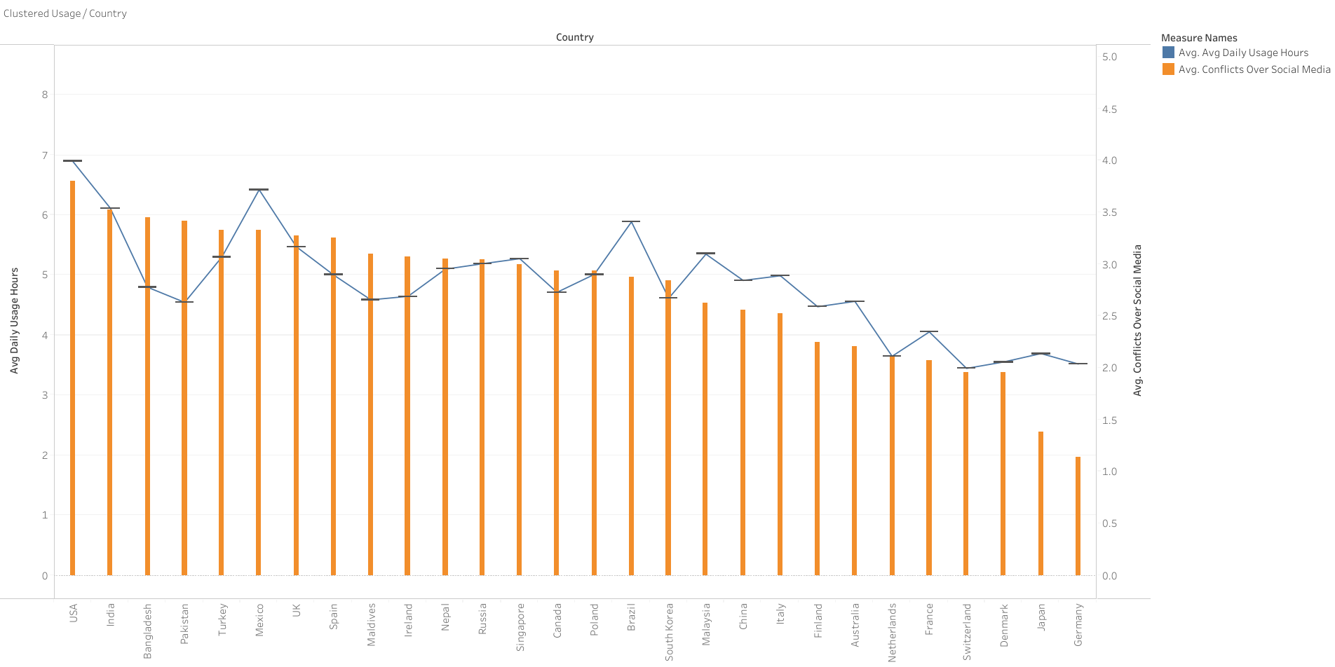
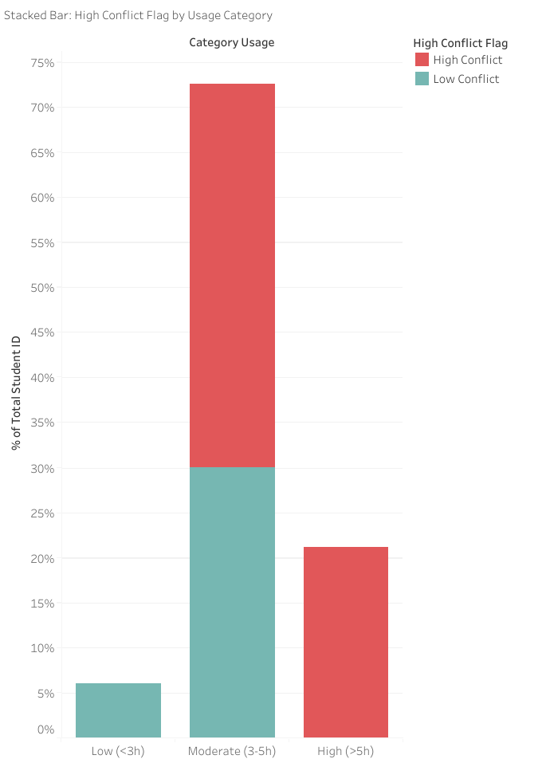
Results Average Daily Usage per Country
The USA and India have the highest daily social media usage (>6 hours/day), but high usage does not always correlate linearly with conflict.
For example, Bangladesh and Pakistan have relatively lower usage hours than the USA, but the resulting conflict is quite high.
The majority of interactions on social media trigger high conflict (>3). This indicates a high potential for negative impacts on mental health, especially in countries with high usage hours.
The higher the usage, the higher the conflicts
The majority of respondents were not low users, but moderate/high users, and more than half had been affected by the conflict.

Slide 23
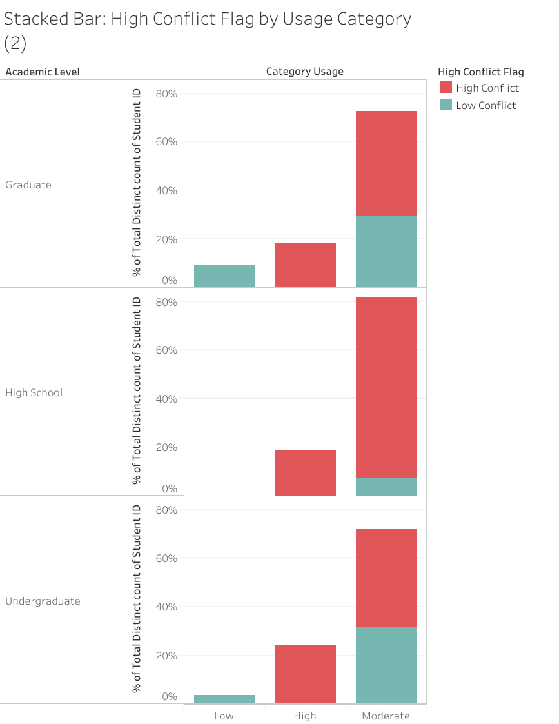
Results by Academic Level
In the first quarter, social media addiction among university and high school students was high and led to social conflicts
High school students were the respondents most affected by high conflict, even at moderate usage levels.
Undergraduate conflict was high at high usage levels, but more balanced at moderate usage levels.
Graduate conflict was still significant, but more controlled than at the high school level.

Slide 24
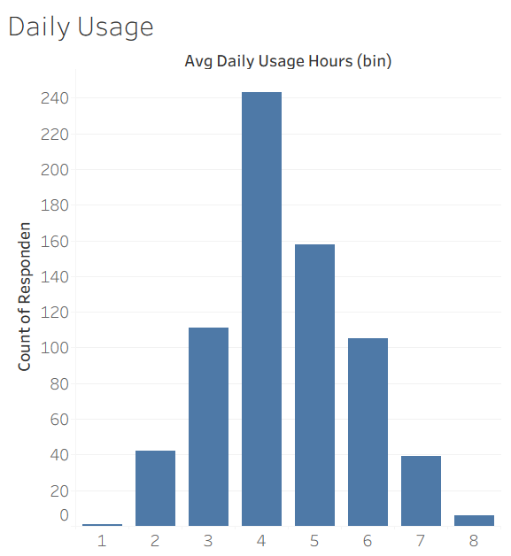
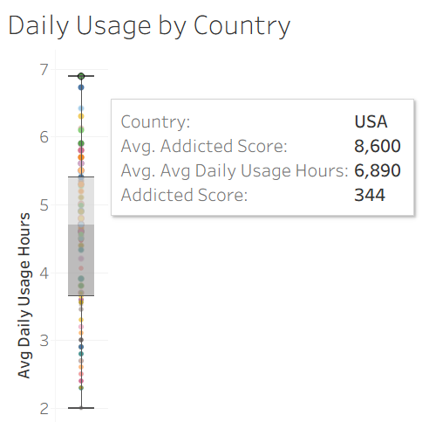
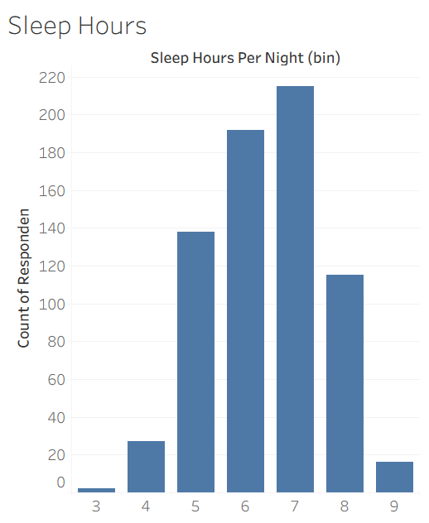
Overview
The majority of respondents were not extreme users, but the average usage of 3–5 hours per day is still high and has the potential to affect lifestyle patterns.
The majority of respondents slept within the healthy range (6–8 hours), but there was a segment that experienced sleep deficit (<6 hours), indicating a negative correlation between hours of usage and hours of sleep.
Outlier heavy users (USA) (>7 hours of use) are at risk of serious problems (sleep, mental health, and social conflicts).
There are no significant differences between countries in average usage, so the focus of intervention should be on individuals.

Slide 25
Bacground
The average social media usage among students is nearly 5 hours/day, which is relatively high.
High usage hours are proven to be associated with decreased sleep hours (<6 hours/day), increased addiction, and decreased mental health scores.
The majority of respondents fall into the moderate usage category (3–5 hours), but this group is actually the most affected by social conflict.
>60% of interactions on social media trigger high conflict, with the peak of conflict occurring in complicated relationship statuses.
Country differences:
The USA and India have the highest usage (>6 hours).
Bangladesh and Pakistan have high conflict despite moderate usage.
Europe (Germany, France, Japan) has low usage and low conflict.
Academic level differences (new graph):
High school students experience the highest levels of conflict, even at moderate usage levels.
Undergraduate conflict is high at high usage levels, but more balanced at moderate usage levels.
Graduate conflict is still significant, but more controlled than at the high school level.

Slide 26
Summary Insight
On average, respondents used nearly 5 hours/day, which could potentially interfere with productivity, sleep patterns, and mental health.
The majority of respondents were in the moderate to high usage category (3–5 hours/day), not low users.
The average sleep time of respondents is less than the CDC recommendation (≥7 hours), with some experiencing sleep deprivation (<6 hours).
There is a negative correlation: the higher the hours of use, the lower the hours of sleep.
Higher addiction scores compared to mental health scores indicate the need for immediate intervention (e.g., education, time reminders).
Positive correlation: the higher the usage, the higher the conflict on social media.
60% of interactions were classified as high conflict, indicating a high risk to mental health.
The highest conflict occurred in the “Complicated” relationship status, followed by Single, and the lowest in In a Relationship.
USA & India: highest usage (>6–7 hours/day).
Bangladesh & Pakistan: although usage hours are lower than in the USA, conflict levels are much higher, indicating that cultural/environmental factors have an influence.
There is no significant difference in average usage between countries; interventions should focus on individuals, not just regions.
Outlier heavy users (e.g., USA >7 hours/day) → the group most at risk for serious problems (sleep, mental health, social conflict).
Moderate users (3–5 hours) are actually the group most significantly affected by conflict (more than half experience high conflict).
High users are already at a low point in terms of mental health, so the impact does not worsen, but they remain at risk of chronic problems.

Slide 27
Recomendation
Short Term (Q2 2025):
Launch screen time monitoring and reminder features for all users.
Implement awareness campaigns (digital wellbeing + sleep hygiene).
Focus on middle-level users in high schools through education and community programs.
Medium Term (Q3–Q4 2025):
Deploy AI-based predictive conflict detectors to identify high-risk users.
Integrate mental health counseling services into the platform.
Localize culturally-based interventions (e.g., focus on social conflict in South Asia vs. digital literacy in Europe).
Short & Medum Term in Q2 2025

Slide 28
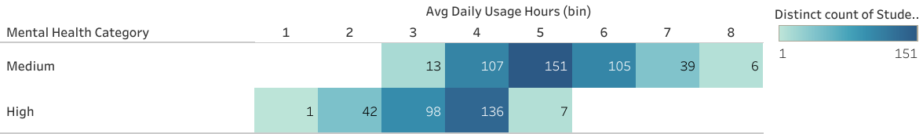
Korelasi Mental Health with Screen Time Responden
High social media usage patterns pose a high risk to mental health
based on the pattern of safe social media usage < 3 hours, and risky > 6 hours

Slide 29
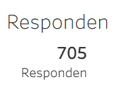
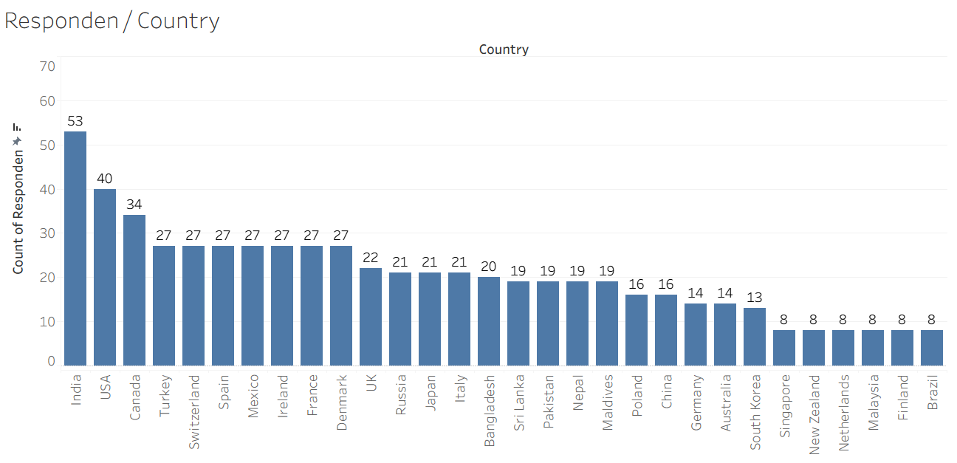
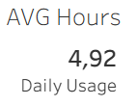
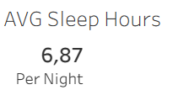
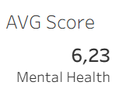
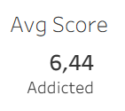
Overview
High social media exposure: Nearly 5 hours per day is a significant amount of time; it has the potential to interfere with productivity and sleep.
Sleep deficit trend: Average sleep time is less than the healthy standard according to the CDC > 7 hours per night, which can contribute to stress, mood swings, and declining mental health.
Addiction > Mental Health: Higher addiction scores than mental health scores indicate the urgency of intervention (nudges, education, time reminder features).
Data bias between countries: Country-specific analysis must account for unbalanced sample sizes.

Slide 30
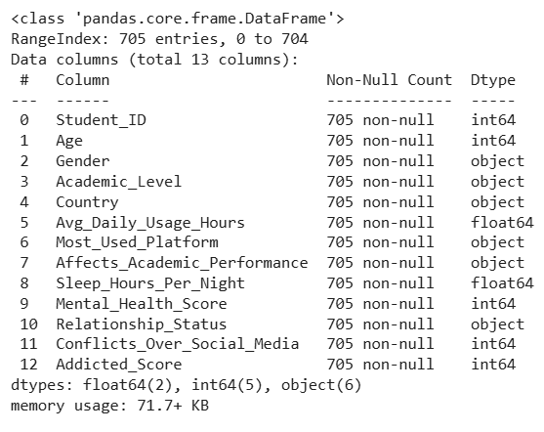
Dataset
Understanding
Students Social Media Addiction 13 Column | 705 Rows

Slide 31

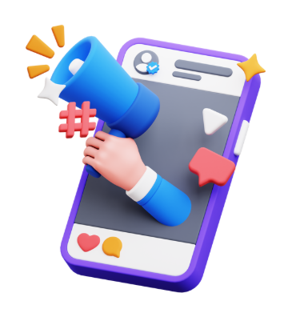
Calm Space
Exploring Students' Social Media Addiction:
Survey Insights from Q1 2025
Mikhael Putra Iswanto
RevoU - FSDA Madrid batch JUN25
Source Collab Tableau Slide

Slide 32
_Calm Space_
Industry Model & Business Processes
As a company that focuses on technology-based mental and social health, Calm Space conducts quarterly surveys, with the current target and objective being the behavior of university and school students in various countries.
The results of this analysis will be integrated into an internal application that can be used by all users, especially college students, school students, and the public.
> Key Business Processes
For Universities/Colleges, Assisting in developing policies related to social media use and student counseling services.
For Researchers/Educators, Serving as a source of data for further research in the fields of education and digital psychology.
> Stakeholder Analysis
705
Responden
110
Total Negara
Decision Maker - CEO
Consulted - Data Scientist, Mental Health Expert
Informed - Stakeholder (Student, NGO, University, Public)
(Approver)
Head of Data & Research
(Responsible)
Data Analyst

Slide 33
Business Problem
Objective (Root Causes Analysis)
“Within 6 months, Calm Space aims to reduce incidents of interpersonal conflict among students due to excessive social media use by 15%, by increasing average sleep quality by more than 30 minutes per night and lowering self-reported anxiety levels.”
Identify the quantitative relationship between social media usage hours and mental health outcomes, sleep duration, and frequency of social conflicts.
Segment users (students) by country and usage patterns to understand intervention priorities per market.
Build a simple predictive model that can estimate the risk of interpersonal conflict based on surveys.
Provide actionable recommendations for stakeholders.

Slide 34
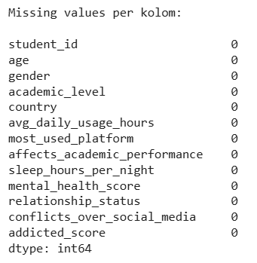
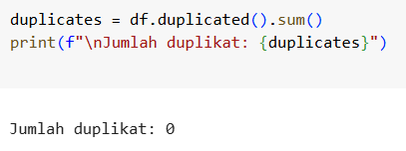
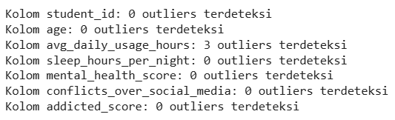
Hasil Temuan
Secure data type (no missing values or duplicates)
The majority of respondents are aged 19-22 years old.
Three outliers were found in avg_daily_usage_hours.
Education: 27 high school, 353 undergraduate, and 325 graduate.

Slide 35
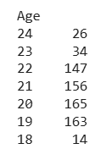
Exploratory Data Analytics
705 responden, berusia dari 18 - 24 Tahun
Mayoritas responden sejak usia 19 - 22 tahun

Slide 36
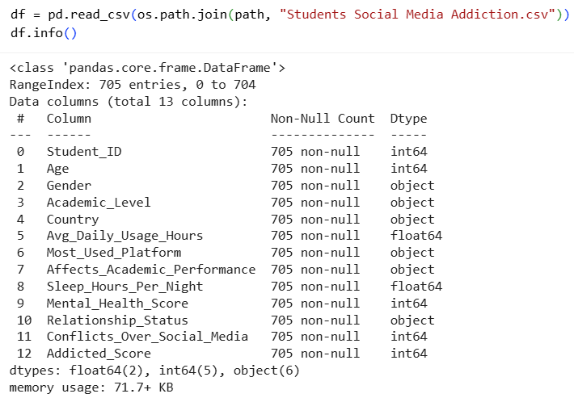
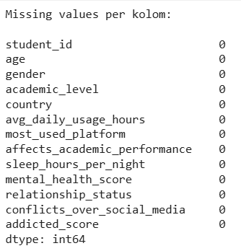
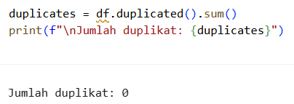
Dataset Awal
0 missing value
Volume Data
705 Baris
13 Kolom
Dataset sudah bersih dan rapi

Slide 37
Type Data
Variable | Type | Description
Student_ID | Integer | Unique respondent identifier
Age | Integer | Age in years
Gender | Categorical | “Male” or “Female”
Academic_Level | Categorical | High School / Undergraduate / Graduate
Country | Categorical | Country of residence
Avg_Daily_Usage_Hours | Float | Average hours per day on social media
Most_Used_Platform | Categorical | Instagram, Facebook, TikTok, etc.
Affects_Academic_Performance | Boolean | Self‐reported impact on academics (Yes/No)
Sleep_Hours_Per_Night | Float | Average nightly sleep hours
Mental_Health_Score | Integer | Self‐rated mental health (1 = poor to 10 = excellent)
Relationship_Status | Categorical | Single / In Relationship / Complicated
Conflicts_Over_Social_Media | Integer | Number of relationship conflicts due to social media
Addicted_Score | Integer | Social Media Addiction Score (1 = low to 10 = high)

Slide 38
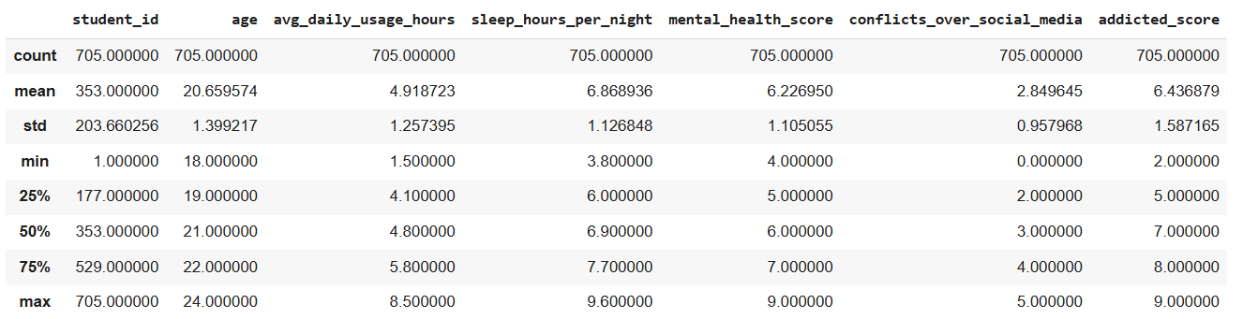
Distribusi Data
Usia mahasiswa berkisar 18-24 tahun, rata-rata 20,65 tahun
Penggunaan Media Sosial rata-rata 4,9 jam/hari di media social, 25% menggunakan <4,1jam, 25% >5,8 jam per hari, ada yang hingga 8,5 jam/hari (berlebihan)
Kualitas Tidur rata-rata jam tidur 6,8 jam/hari (relative sehat namun ada di batas Bawah), ada yang tidur hanya 3,8 jam (potensi gangguan tidur)
Kesehatan Mental score (skala 1-10) rata-rata 6.2 (cukup stabil, tapi tidak tinggi), ada mahasiswa skor 4 (rentan dalam psikologis), 25% berada pada skor <5 (rawan masalah mental health)
Konflik karena social media (skala 0-5), rata-rata 2.8, 50% mahasiswa >3 (artinya cukup tinggi), ada mahasiswa tidak mengalami dengan skor 0 , tetapi ada juga yang selalu konflik dengan skor 5
Tingkat Adiksi (skala 1-10), rata-rata skor 6,4 (di level menengah ke tinggi), Sebagian mahasiswa adiksi maksimum 9 (menunjukkan kasus kecanduan berat)

Slide 39
Insight
Tingginya penggunaan media sosial (hampir 5 jam/hari) berhubungan dan berkaitan dengan tingginya konflik dan skor adiksi. Tidak ada benchmark resmi dunia (WHO/CDC/UNICEF) durasi ideal penggunaan handphone usia remaja - dewasa
Kualitas tidur sebagian mahasiswa terganggu (tidur <5 jam) → bisa dikaitkan dengan penggunaan sosial media berlebih. #Benchmark Otoritas kesehatan CDC merekomendasikan (18–60 th) ≥7 jam per malam secara teratur
Kesehatan mental cukup stabil di rata-rata (6,2), tetapi terdapat kelompok mahasiswa yang rentan (skor ≤5). Skala 1-10 berupa perbandingan internal bukan standar resmi
Adiksi sosial media nyata di kalangan mahasiswa, dengan rata-rata tinggi (6,4) dan beberapa kasus ekstrem (9/10). Skala 1-10 berupa perbandingan internal, Untuk penilaian yang lebih valid, perlu konversikan skala 1–10 ke instrumen baku seperti BSMAS atau gunakan BSMAS di survei lanjutan.

Slide 40
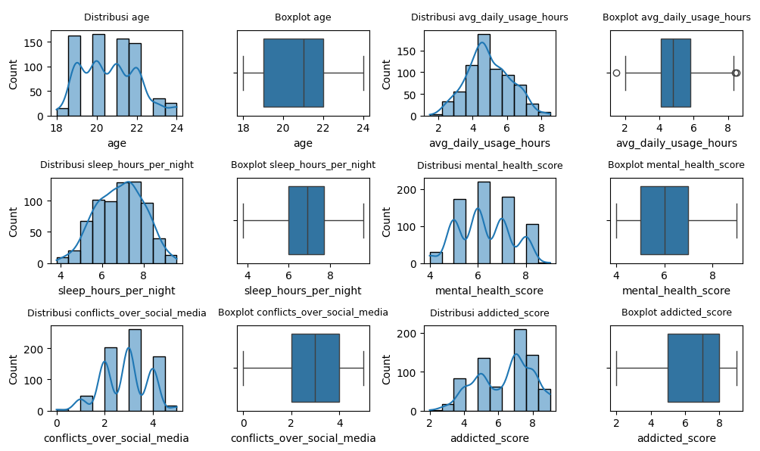
Distribusi (histogram, boxplot)
Insight
Menunjukkan data diambil dari populasi mahasiswa/anak muda (18-24th).
Tinggi penggunaan media sosial (≥6 jam/hari) berkorelasi dengan tingkat adiksi yang lebih tinggi.
Tidur yang kurang (<6 jam) cenderung berhubungan dengan skor kesehatan mental yang rendah.
Adiksi tinggi bisa berkontribusi terhadap konflik sosial serta penurunan mental health score.
Kelompok usia muda (18–24) rentan terhadap adiksi media sosial dan konflik interpersonal, sehingga penting intervensi preventif.

Slide 41
Data Outlier (IQR)
Outliers (IQR)
Outliers student_id (IQR):
Series([], Name: student_id, dtype: int64)
Outliers age (IQR):
Series([], Name: age, dtype: int64)
Outliers avg_daily_usage_hours (IQR):
6 1.5
486 8.4
496 8.5
Name: avg_daily_usage_hours, dtype: float64
Outliers sleep_hours_per_night (IQR):
Series([], Name: sleep_hours_per_night, dtype: float64)
Outliers mental_health_score (IQR):
Series([], Name: mental_health_score, dtype: int64)
Outliers conflicts_over_social_media (IQR):
Series([], Name: conflicts_over_social_media, dtype: int64)
Outliers addicted_score (IQR):
Series([], Name: addicted_score, dtype: int64)
#Outlier
Data masih relevan tidak perlu dihapus

Slide 42
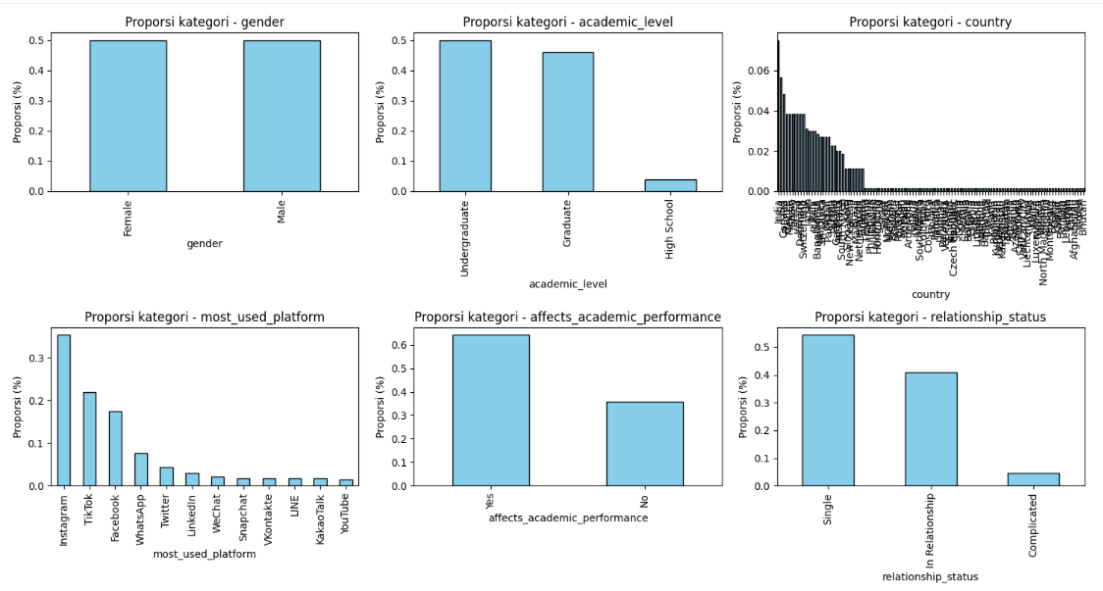
Proporsi per kategori

Slide 43
Insight
Mayoritas responden mahasiswa usia kuliah (Undergraduate, 18–24 tahun) dengan status Single rentan menghabiskan banyak waktu di media sosial.
Platform utama yang dipakai adalah Instagram, TikTok, Facebook, dan Whatsapp, yang dikenal sangat adiktif selaras dengan temuan skor adiksi tinggi.
Lebih dari separuh responden mengaku akademiknya terganggu karena media sosial ini mendukung adanya hubungan antara lama penggunaan dan turunnya performa belajar.
Karena dataset multi-negara, ada peluang untuk analisis perbedaan budaya: misalnya negara mana yang paling tinggi penggunaan TikTok, atau dampak akademiknya lebih besar di mana.

Slide 44
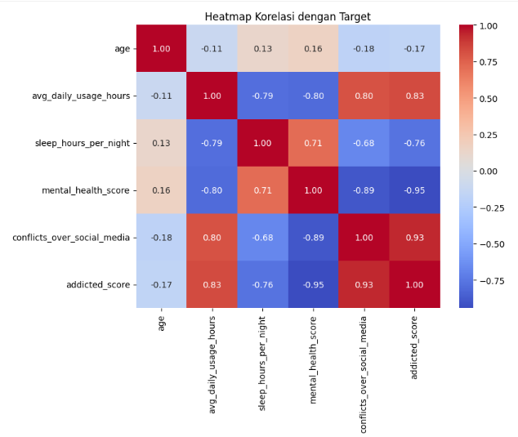
Korelasi (Numerik vs Addicted Score)

Slide 45
Insight
avg_daily_usage_hours ↔ addicted_score ≈ +0.8 → sangat positif. Semakin lama rata-rata pakai media sosial, semakin tinggi skor kecanduan.
avg_daily_usage_hours ↔ sleep_hours_per_night ≈ −0.8 → kuat negatif. Pakai banyak → tidur berkurang.
avg_daily_usage_hours ↔ mental_health_score ≈ −0.8 → kuat negatif. Pakai banyak → kesehatan mental (skor) menurun.
conflicts_over_social_media ↔ addicted_score ≈ +0.9 → sangat kuat. Konflik terkait media sosial berjalan seiring dengan skor kecanduan.
addicted_score ↔ mental_health_score ≈ −0.95 → sangat kuat negatif. Skor kecanduan tinggi hampir selalu berasosiasi dengan mental health rendah.
age korelasinya lemah ke variabel utama → usia tampaknya bukan driver utama.
Intinya: jalur yang jelas muncul adalah avg_daily_usage_hours ↑ → addicted_score ↑ → conflicts ↑ & sleep ↓ → mental_health ↓.

Slide 46
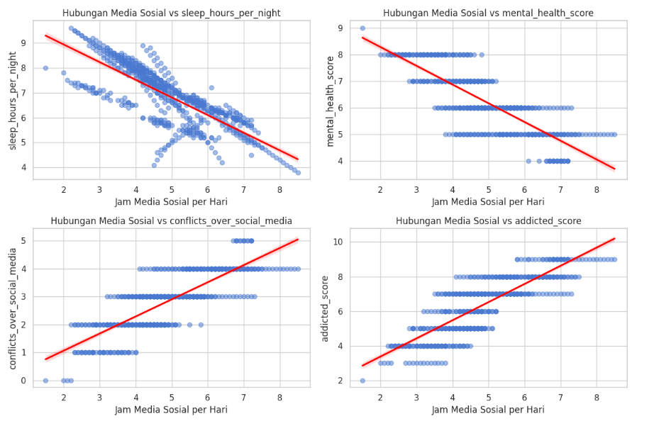
Korelasi (Numerik vs Addicted Score)

Slide 47
Media Sosial vs Sleep Hours (jam tidur per malam)
Pola: Garis tren menurun tajam → semakin lama penggunaan media sosial, semakin sedikit jam tidur.
Insight: Ada hubungan negatif kuat → penggunaan media sosial berlebihan mengurangi kualitas & kuantitas tidur (contoh: dari 8–9 jam turun ke 4–5 jam/hari).
Ini konsisten dengan riset kesehatan global → paparan layar berlebih ganggu melatonin & jam biologis.
Media Sosial vs Mental Health Score
Pola: Garis tren menurun → makin tinggi durasi media sosial, makin rendah skor kesehatan mental.
Insight: Ada hubungan negatif → penggunaan sosial media berlebihan terkait dengan stres, cemas, atau depresi lebih tinggi.
Ini sejalan dengan WHO & penelitian psikologi bahwa overuse medsos bisa memicu FOMO (fear of missing out), perbandingan sosial, dll.
Media Sosial vs Conflicts Over Social Media
Pola: Garis tren menanjak positif → semakin lama pakai media sosial, makin banyak konflik (misalnya debat, toxic comment, masalah pertemanan).
Insight: Ada hubungan positif moderat → penggunaan medsos lama memperbesar potensi konflik interpersonal.
Bisa terkait cyberbullying, perselisihan opini, atau masalah privasi.
Media Sosial vs Addicted Score
Pola: Garis tren positif tajam → makin lama penggunaan, makin tinggi tingkat adiksi.
Insight: Hubungan sangat kuat → durasi tinggi menjadi indikator jelas adiksi media sosial.
Skor adiksi naik hampir linier dengan jam penggunaan → >6 jam/hari sudah masuk zona adiksi serius.

Slide 48
Layout Dashboard
Total Responden
Avg Daily Usage
Avg Sleep Hours/Night
Avg Score Mental Health
Avg Score Addicted
Daily Usage / Country
Daily Usage
Sleep Hours
Correlate Daily Usage vs Sleep Hours

